Slide 1
Fundamentals of Software Engineering
Week 4

Slide 2
Rapid Software Development
Because of rapidly changing business environments, businesses have to respond to new opportunities and competition.
This requires software rapid development and delivery is not often the most critical requirement for software systems.
Businesses may be willing to accept lower quality software if rapid delivery of essential functionality is possible.
Due to the changing environment
it is often impossible to arrive at a stable, consistent set of system requirements.
A waterfall model of development is impractical
An approach to development based on iterative specification and delivery is the only way to deliver software quickly.

Slide 3
Rapid Application Development
Proposed by IBM in 1980
RAD(rapid application development) is software methodology focusing on building softwares in a very short duration.
It is incremental model, works iteratively
Uses component based construction
Component can be a running application, library, applet, software, build functionality
Multiple teams working together on different modules which are integrated later
RAD requires sufficient human resources to create teams
It is not appropriate where technical risk is high
Useful for projects that are time boxed and high performance is not required.
RAD(rapid application development) model fallowed when customer requirements are same as another application. Then same application copy is developed.
Notes:
Component= any functionality, software, part of application or piece of code

Slide 4
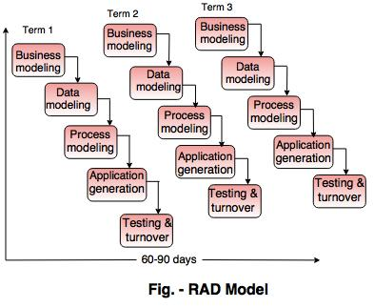
Rapid Application Development
Notes:
Component= any functionality, software, part of application or piece of code

Slide 5
Methodologies -Review
There are many different methodologies in use for software engineering
Plan-based software engineering produces a large amount of documentation for sustainable projects
Waterfall, Incremental, Spiral
Agile-based software engineering sacrifices documentation for earlier release dates and more adaptability to changing requirements
eXtreme Programming (XP), Scrum, Scrum-but

Slide 6

Agile software development
Agile software development is a group of software development methodologies based on iterative and incremental development, where requirements and solutions evolve through collaboration between self-organizing, cross-functional teams.

Slide 7
Agile Values / Manifesto for Agile Software Development
Agile is not just a methodology but a philosophy
“uncovering better ways of developing software by doing it and helping others do it”
Through this work, we have come to value:
Individuals and interactions over processes and tools
Working software over comprehensive documentation
Customer collaboration over contract negotiation
Responding to change over following a plan
That is, while there is value in the items on the right, we value the items on the left more
Notes:
Agile means respond to change (agility), Able to think and change quickly

Slide 8
Individuals and Interactions over Processes and Tools
Focus on good people who work well together.
A good team with no process (or, worse, a bad one) is better than a bad team with a good process…
Ideally the team should be made up of “generalizing specialists” –
people who specialize in something, but are conversant(having frequent or familiar association) in all the disciplines the team needs.

Slide 9
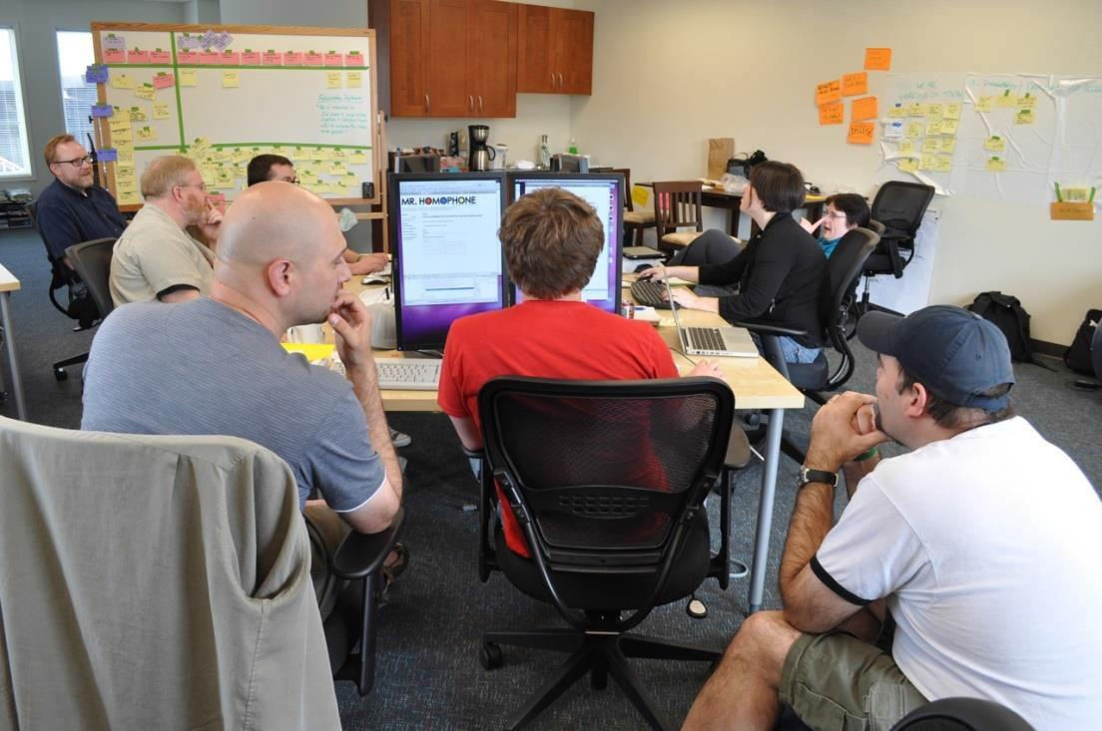
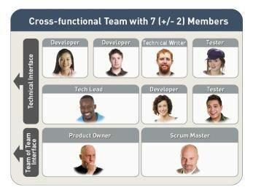
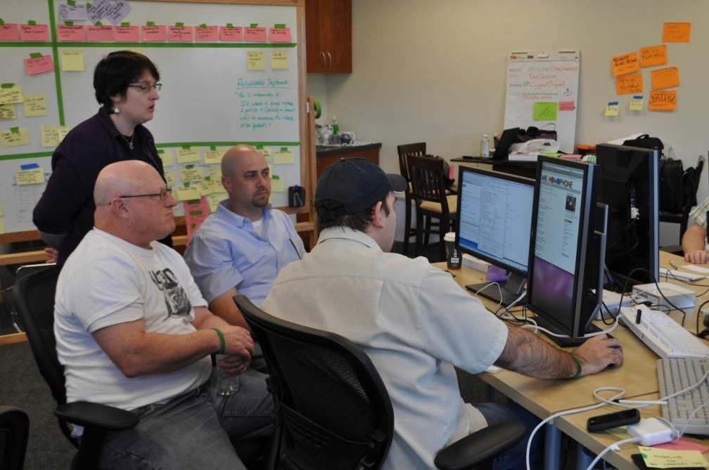
A Good Team

Slide 10
Working Software over Comprehensive Documentation
We’re not paid to develop documentation, we’re paid to develop software.
Of course that doesn’t mean that documentation is unimportant, but it has to be considered relative to its cost in delivering functionality (i.e, software).
Traditional development stress on flawless documentation.

Slide 11
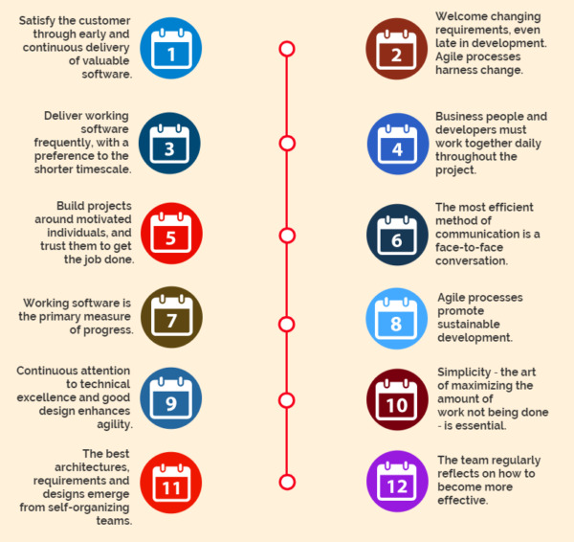
12 Agile Principles
Notes:
Agile means respond to change (agility), Able to think and change quickly

Slide 12
Principles of Agile Methods
Principle
Description
Customer involvement
The customer should be closely involved throughout the development process.
Their role is provide and prioritise new system requirements
and to evaluate the iterations of the system.
Incremental delivery
The software is developed in increments with the customer specifying the requirements to be included in each increment.
The skills of the development team should be recognised and exploited.
The team should be left to develop their own ways of working without prescriptive processes.
People not process
Embrace change
Expect the system requirements to change and design the
system so that it can accommodate these changes.
Maintain simplicity
Focus on simplicity in both the software being developed and in the development process used.

Slide 13
Unified Process Model
Offered by Rational/IBM, UP developed by Booch, Rumbaugh, and Jacobson
Object-oriented system development methodology (system development process)
The Unified Process recognizes the importance of customer communication and streamlined methods for describing the customer’s view of a system. It emphasizes the important role of software architecture and “helps the architect focus on the right goals, such as understandability, reliance to future changes, and reuse”.
UP should be tailored to organizational and project needs
Highly iterative life cycle
a process flow that is iterative and incremental, providing the evolutionary feel that is essential in modern software development.
Project will be use-case driven and modeled using UML

Slide 14
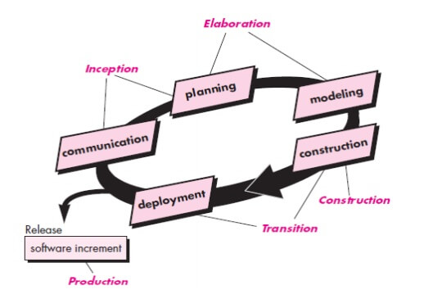
Unified Process Model (Contd.)
UP life cycle:
Includes four phases which consist of iterations
Iterations are “mini-projects”
Four Phases:
Inception – develop and refine system vision
Elaboration – define requirements and design and implement core architecture
Construction – continue design and implementation of routine, less risky parts
Transition – move the system into operational mode

Slide 15
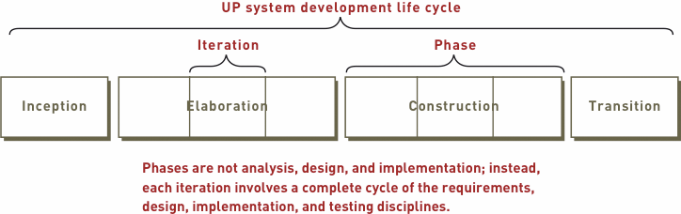
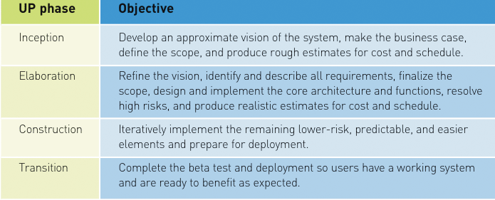
Unified Process Model (Contd.)

Slide 16
Unified Process Model (Contd.)
Related development activities are called disciplines
UP disciplines:
Business modeling, requirements, design, implementation, testing, deployment, project management, configuration and change management, and environment
Each iteration includes activities from all disciplines
Activities in each discipline produce artifacts – models, documents, source code, and executables

Slide 17
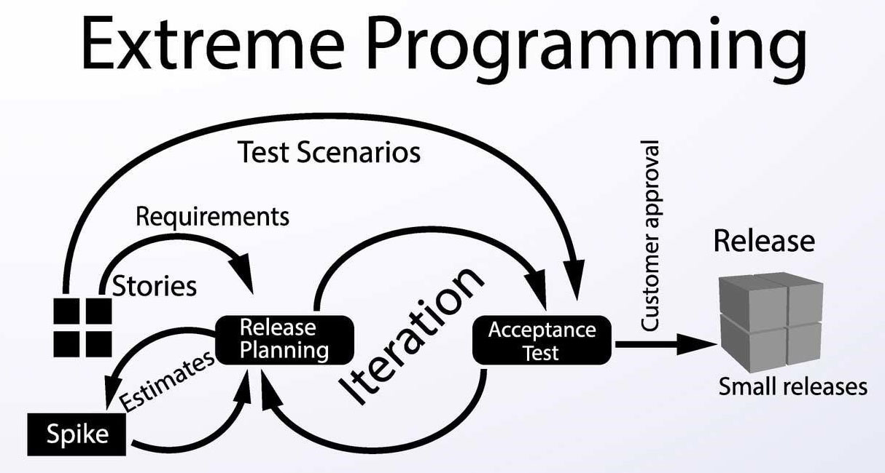
eXtreme Programming (XP)
eXtreme Programming (XP) was conceived and developed to address the specific needs of software development by small teams in the face of vague and changing requirements.
Extreme Programming is one of the Agile software development methodologies. It provides values and principles to guide the team behavior.

Slide 18
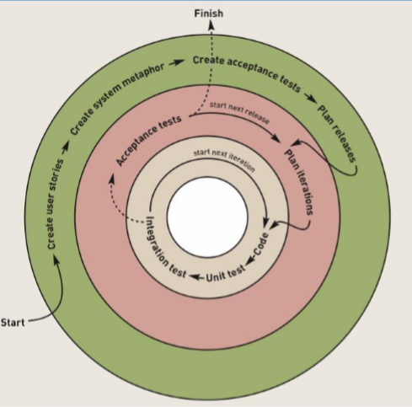
eXtreme Programming (XP)
Notes:
http://ronjeffries.com/xprog/what-is-extreme-programming/circles.jpg

Slide 19
Values of XP
Communication
Software development is inherently a team sport that relies on communication to transfer knowledge from one team member to everyone else on the team. XP stresses the importance of the appropriate kind of communication – face to face discussion with the aid of a white board or other drawing mechanism.
Simplicity
Simplicity means “what is the simplest thing that will work?” The purpose of this is to avoid waste and do only absolutely necessary things such as keep the design of the system as simple as possible so that it is easier to maintain, support, and revise. Simplicity also means address only the requirements that you know about; don’t try to predict the future.
Feedback
Through constant feedback about their previous efforts, teams can identify areas for improvement and revise their practices. Feedback also supports simple design. Your team builds something, gathers feedback on your design and implementation, and then adjust your product going forward.
Courage
You need courage to stop doing something that doesn’t work and try something else. You need courage to accept and act on feedback, even when it’s difficult to accept.

Slide 20

Practices of XP
1) Code Review:
Code review detects and corrects errors efficiently. It suggests pair programming as coding and reviewing of written code carried out by a pair of programmers who switch their works between them every hour.
2) Simple Design
Simplicity makes it easier to develop good quality code as well as to test and debug it.
Enough to meet customer requirements
No duplicate Functionality
Fewest possible classes and methods
Simple the design is, more easy to adapt change

Slide 21
Practices of XP
3- Code Refactoring
To deliver business value with well-designed software in every short iteration, XP teams also use refactoring. The goal of this technique is to continuously improve code. Refactoring is about removing redundancy, eliminating unnecessary functions, increasing code coherency, and at the same time decoupling elements. Keep your code clean and simple, so you can easily understand and modify it when required would be the advice of any XP team member.
4- Continuous Integration
Developers always keep the system fully integrated. Extreme programming suggests that the developers should achieve continuous integration by building and performing integration testing several times a day.
5- Small Releases
This practice suggests releasing the first version quickly and further developing the product by making small and incremental updates. Small releases allow developers to frequently receive feedback, detect bugs early, and monitor how the product works in production.

Slide 22
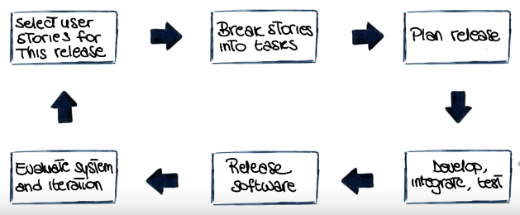
Practices of XP
6- Incremental development:
Incremental development is very good because customer feedback is gained and based on this development team come up with new increments every few days after each iteration.

Slide 23
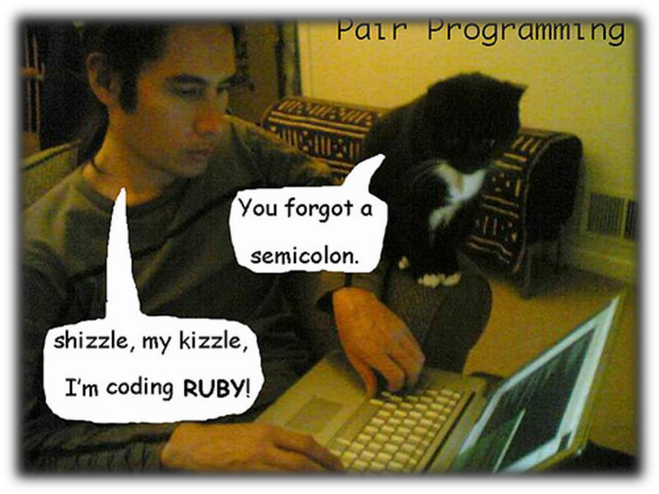
Practices of XP
7- Test-Driven Development
XP teams practice test-driven development technique (TTD) that entails writing an automated unit test before the code itself. According to this approach, every piece of code must pass the test to be released. XP suggests test-driven development (TDD) to continually write and execute test cases. In the TDD approach test cases are written even before any code is written.
8- On-site Customer
According to XP, the end customer should fully participate in development. The customer should be present all the time to answer team questions, set priorities, and resolve disputes, if necessary.
9- Pair Programming
This practice requires two programmers to work jointly on the same code. While the first developer focuses on writing, the other one reviews code, suggests improvements, and fixes mistakes along the way. Such teamwork results in high-quality software faster

Slide 24
Pair Programming in XP
Programmers work in pairs to develop software
Supports the idea of collective ownership
Acts as an informal review process
Helps support refactoring
The productivity of most pair programming actually rivals that of two programmers working independently
Less rework, fewer errors
With more experienced programmers, the productivity is typically lower than two independent programmers though higher than one programmer

Slide 25
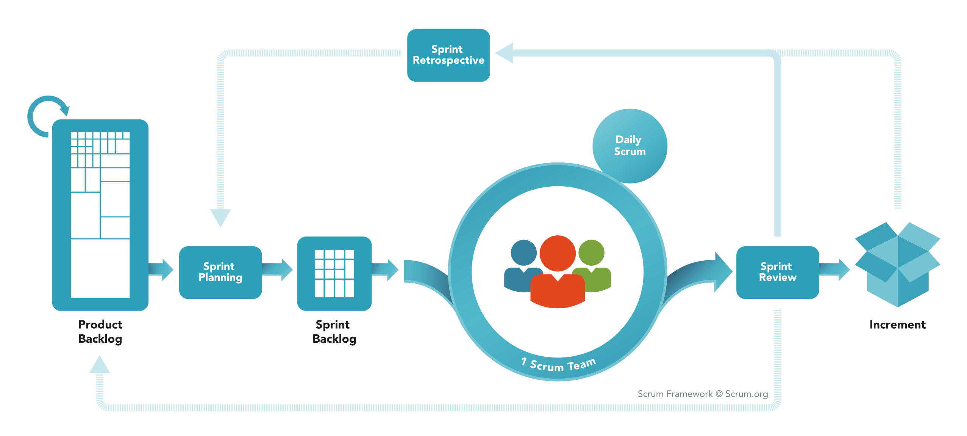
Scrum
Scrum focuses on managing iterative development rather than specific technical approaches to agile software engineering

Slide 26

Scrum framework
Roles
Product owner
ScrumMaster
Team
Ceremonies
Sprint planning
Sprint review
Sprint retrospective
Daily scrum meeting
Artifacts
Product backlog
Sprint backlog
Burndown charts

Slide 27
Scrum framework
Roles
Product owner
ScrumMaster
Team
Ceremonies
Sprint planning
Sprint review
Sprint retrospective
Daily scrum meeting
Artifacts
Product backlog
Sprint backlog
Burndown charts

Slide 28

Product owner
Define the features of the product
Decide on release date and content
Be responsible for the profitability of the product (ROI)
Prioritize features according to market value
Adjust features and priority every iteration, as needed
Accept or reject work results

Slide 29

The ScrumMaster
The scrum master (not project manager) is a facilitator who arranges daily meetings, tracks the backlog, records decisions, measures progress, and communicates with customers
The scrum master can change for each sprint

Slide 30





The team
Typically 5-9 people
Cross-functional:
Programmers, testers, user experience designers, etc.
Members should be full-time
May be exceptions (e.g., database administrator)

Slide 31
Scrum framework
Roles
Product owner
ScrumMaster
Team
Ceremonies
Sprint planning
Sprint review
Sprint retrospective
Daily scrum meeting
Artifacts
Product backlog
Sprint backlog
Burndown charts

Slide 32



Sprint planning meeting
Team capacity
Sprint prioritization
Analyze and evaluate product backlog
Select sprint goal
Sprint
goal
Product backlog
Business conditions
Sprint planning
Decide how to achieve sprint goal (design)
Create sprint backlog (tasks) from product backlog items (user stories / features)
Estimate sprint backlog in hours
Current product
Sprint
backlog
Technology

Slide 33
Sprint
Sprint is one timeboxed iteration (normally 4 weeks) of a continuous development cycle.
Within a Sprint, planned amount of work has to be completed by the team and made ready for review.
The starting point for planning is the product backlog, which is the list of work to be done on the project
The selection phase involves all of the project team who work with the customer to select the functionality to be developed in the sprint
The team organizes themselves to develop the software through short daily meetings to review progress and possibly reprioritize work
At the end of the sprint, the work is reviewed and presented to stakeholders before beginning the next sprint cycle

Slide 34
Sprint planning
Team selects items from the product backlog they can commit to completing
Sprint backlog is created
Tasks are identified and each is estimated (1-16 hours)
Collaboratively, not done alone by the ScrumMaster
High-level design is considered

Slide 35
The daily scrum
Daily Scrum is an internal meeting for the Development Team for 15-minutes
A short daily Scrum meeting to report progress don’t ask solutions
Following questions are asked in daily scrum:
What did you do yesterday?
What will you do today?
Are there any blockers or impediments preventing you from doing your work?

Slide 36
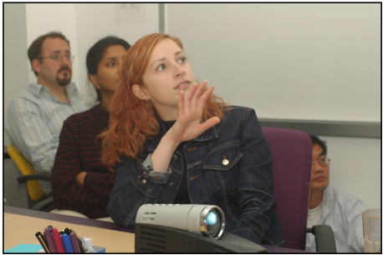

The sprint review
Team presents what it accomplished during the sprint
Typically takes the form of a demo of new features or underlying architecture
Informal
2-hour prep time rule
No slides
Whole team participates

Slide 37
Sprint retrospective
Periodically take a look at what is and is not working
Typically 15–30 minutes
Done after every sprint
Whole team participates
ScrumMaster
Product owner
Team
Possibly customers and others

Slide 38
Scrum framework
Roles
Product owner
ScrumMaster
Team
Ceremonies
Sprint planning
Sprint review
Sprint retrospective
Daily scrum meeting
Artifacts
Product backlog
Sprint backlog
Burndown charts
Notes:
https://www.scrum.org/resources/what-is-scrum

Slide 39

Product backlog
The requirements
A list of all desired work on the project
Ideally expressed such that each item has value to the users or customers of the product
Prioritized by the product owner
Reprioritized at the start of each sprint
This is the product backlog

Slide 40
A sample product backlog
Backlog item | Estimate
Allow a guest to make a reservation | 3
As a guest, I want to cancel a reservation. | 5
As a guest, I want to change the dates of a reservation. | 3
As a hotel employee, I can run RevPAR reports (revenue-per-available-room) | 8
Improve exception handling | 8
... | 30
... | 50

Slide 41
Managing the sprint backlog
Individuals sign up for work of their own choosing
Work is never assigned
Estimated work remaining is updated daily
Any team member can add, delete or change the sprint backlog
Work for the sprint emerges
If work is unclear, define a sprint backlog item with a larger amount of time and break it down later
Update work remaining as more becomes known

Slide 42
A sprint backlog
Tasks
Mon
Tues
Wed
Thur
Fri
Code the user interface
8
4
8
Code the middle tier
16
12
10
4
Test the middle tier
8
16
16
11
8
Write online help
12
Write the foo class
8
8
8
8
8
Add error logging
8
4

Slide 43
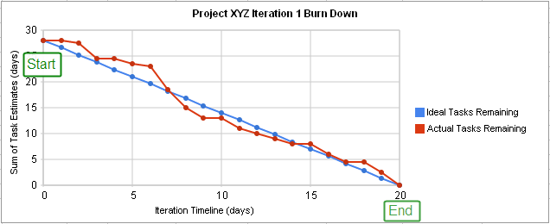
A sprint burndown chart

